Slide 1
Cat-Tastic Case Study

Slide 2
Preface -
I had this elaborate idea and realized the scope was too big for what time I had. But I also had half my slides already made. But then I worried my slides wouldn’t be enough so I also filled out the outline that was provided resulting in two submissions.
Why did I not stick to the outline in the first place? Well I wanted to go above and beyond. Unfortunately I had to shift gears but I am still happy with my research and solution.
Continue on for my edited down version. Slide 28 starts the outlined version. They are slightly different in flow and what data is presented. Major difference is detailed, walkthrough wireframe is in first one and screengrabs of work from figma is in second. Sorry I’m taking up your time submitting two version.

Slide 3
Table of Contents
Overview
The Application, The Problem, The Solution
Market Research - Finding User Value
App Discovery, App Usage, App Referral
App Discovery - User Research
App Usage - User Research
App Referral - User Research
User Survey Results for Signups
User Value - Filtered Results
Solution Breakdown
Wireframes
Breakdown of wireframe and solution walkthrough
Wireframe Feedback
Conclusion
Market Research - Works Cited
Survey #1 & Survey #2 hyperlinks
Scope Prevention / Future Features
Rundown of scope preventions and Future Features
Unused - Gamification

Slide 4
Overview

Slide 5
The Application
Cat-tastic is a social media application similar to Instagram.
A user posts pictures of their cats and other users like and comment those posts.
The Problem
Cat-tastic needs more signups. Only 30% of 2,000 daily users sign up. That’s only 600 users.
The Solution
Quick, simple, and engaging sign-in process. Imbued in this process is gamification and ad based FOMO.

Slide 6
Market Research
Finding User Value

Slide 7
App Referral
Similar to discovery but analyzing the social aspect of sharing an app to another. And the added dynamic of FOMO.
03
App Discovery
Ways a user is introduced to an app and decide to use it.
01
02
App Usage
Downloading and signups are focus here. Roadblocks and frustrations explored. .

Slide 8
App Discovery
80%
75%
75%
70%
50%
Use Apps to Connect With Others
Download Apps
Vs
Web Apps
Ads
Word of Mouth
Google Search
Results -
Users prefer to download an app vs using an app online. Users use apps to socialize. Word of mouth and Google search are a big component in discovery a new app. And half the time, ads help share the news of a new app.
User value -
Making sure app has a mobile version. Utilize the social aspect of the app. Find ways to get users to connect with people they know that don’t have the app yet. Look into ads and SEO tool.

Slide 9
App Usage
Signup
Downloading
Updates
100%
20%
100%
80%
Not enough phone storage
Speed
Fully finish filling out bio
Has been prevented from downloading an app
Mobile > Desktop
Took too long to download
80%
Hardware restrictions
Dense > Wordy
Forms
Results -
All users have been prevented from downloading an app. Some issues are hardware while others are software. Balancing restrictions you can’t control vs restrictions you can. And the obvious, speed is ruler.
User value -
Usability, lightweight, adaptive to all sorts of hardware. Speed. Small bio forms.

Slide 10
App Referral
Promotions
User to User
60%
20%
75%
40%
Sign-up coupons
Through social media / FOMO
Refer-A-Friend Code
Word of mouth
Results -
More than half use a refer-a-friend code. But hardly any like signup codes. The social aspect of codes seems to be the winner. Instead of advertising on the app, have a user get rewarded for telling others about a great deal.
User value -
The app is background. User to user is prominent. Make it seem like the app is just a meeting place and the value comes from user to user interactive. Promoting user connection seems to be the winner.

Slide 11
User Survey Results for Signups
Users
Roadblocks/Pet Peeves
Frustrations
Fast Signups
1
Remember multiple passwords/usernames
Too complicated to create a password or if I get more than 2 errors during account creation I'm out
Has a signup process been too long that you gave up? Yes! Email and passwords should be all.
2
Too many personal credentials especially on a shady site
Having to go through multiple steps to get started.
Has a signup process been too long that you gave up? Yes! I like quick account signups like using Google.
3
Spammed with news and advertisements
Stopping momentum by forcing a sign-up page.
Has a signup process been too long that you gave up? Yes! Short forms are a must.
4
Hate typing with thumbs
Quick use sites requiring sign-up to use
Has a signup process been too long that you gave up? Yes! Though I don’t mind a thorough form if necessary.
5
Form too long. Ruins flow.
Lying about how much info is needed to use service or get sign-up code
Has a signup process been too long that you gave up? Yes! Quick and speedy. I prefer biometrics.

Slide 12
User Value
Speedy, bite-sized, social interactive, and lightweight. These are filtered terms to highlight the user value needed to create the solution needed to help bolster Cat-tastic signups.
Bolster Access + Tear Down Roadblock = User Value

Slide 13
Solution
Filter necessary information needed to use in initial form
Quick and simple
Don't disrupt the user flow
Fun and interactive
Don’t prevent the user from viewing other users posts. That way there isn’t a roadblock preventing the initial social aspect of the app. Get users already engaging, and when they have to sign up, FOMO will kick in.
While the user is scrolling through Cat-tastic, they will forget they are not signed up and will want to like/comment on a post. At that time a message box opens up underneath the post. The user is not taken to another page. Their flow is not interrupted.
The message is playful and interactive. This message box turns into a signup form. It will be bite-sized and interactive. Once the user is done, the box closes and the icon the user pressed at the start will fill in and the user can continue on their flow.

Slide 14
Wireframes

Slide 15
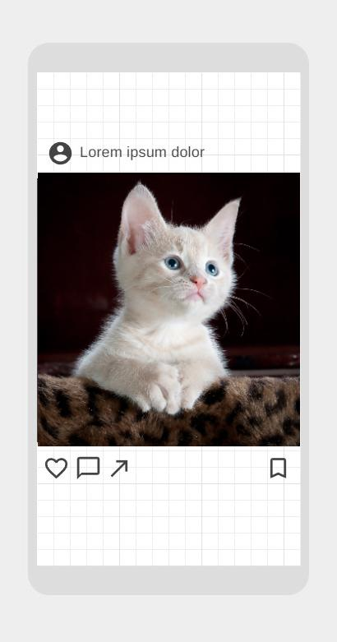
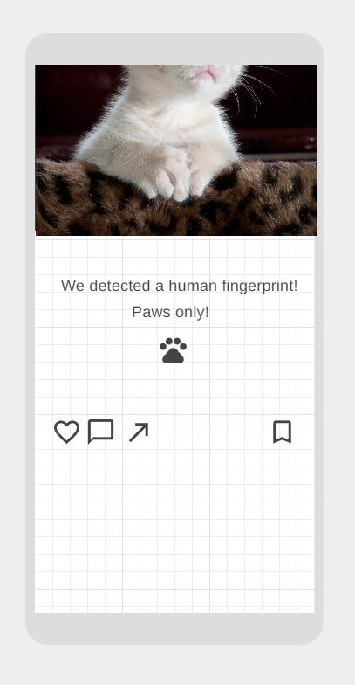
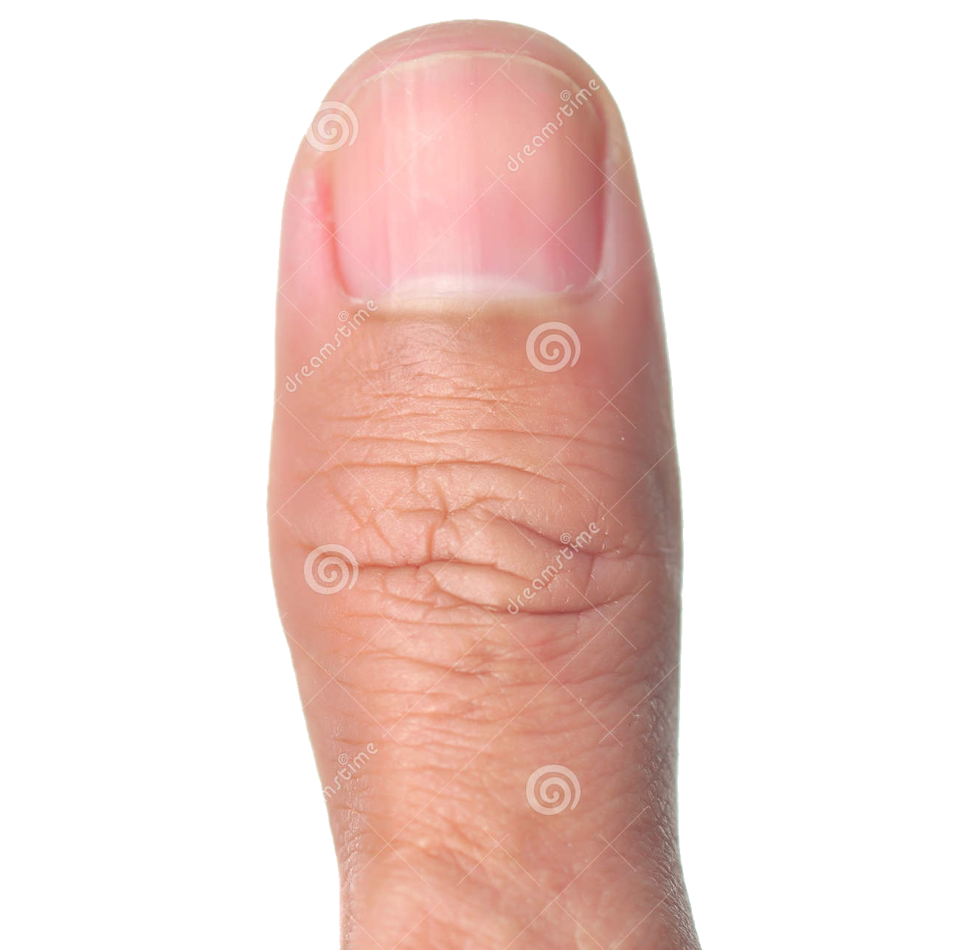
…will trigger the signup prompt, sliding the picture and buttons out of the way
Pressing a notification button….

Slide 16
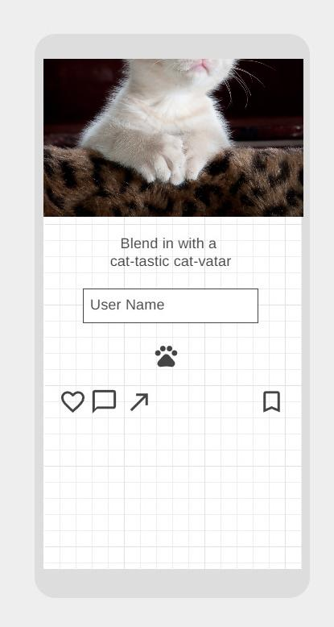
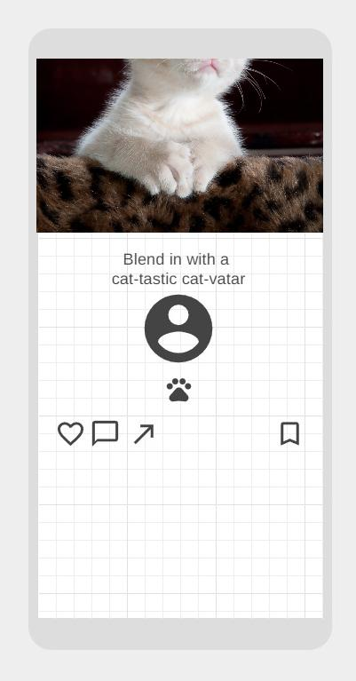
Fun, bite sized, interactive sign up.
Not only is the user playing along and creating a secret cat identity, the user in this first step is only asked for one piece of information to lessen the heft of an overwhelming signup page.
By focusing on smaller breadcrumbs, it’s more engaging and not distracting.
Plus it’s fun trying to come up with a cat persona!

Slide 17
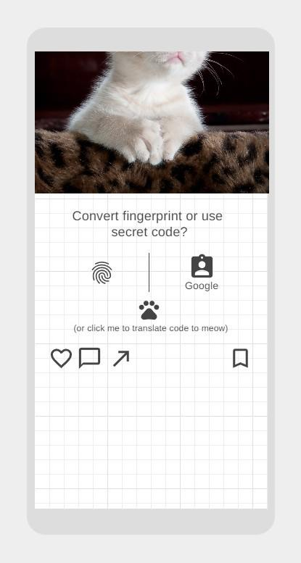
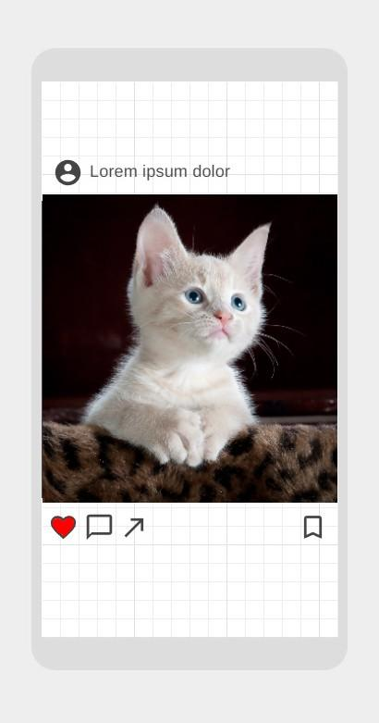
You can choose fingerprint, google sign-in, or create your own password.
Once done, the pictures and buttons automatically move back into place, the button the user pressed gets filled in, and the user continues on where they left off as if their flow never got interrupted!

Slide 18
Wireframe Feedback

Slide 19
01
Success! - single page
Work on - make it clear wireframe is focusing on one user post and not showing infinite scroll
Success! - interactive, playful sign-up is working
Enjoys having sign up on same page.
Too much white space.
Gamifying is fun.
02
Work on - Don’t make biometric prominent. Between using the word fingerprint, showing a cat paw, and having a fingerprint symbol, it may be sending the wrong signal
Work on - adjust wireframe or explain better why icons have been adjusted.
Not a fan of biometrics.
Icons and image not aligning throughout process.
03
Success! - biometrics should be incorporated because this is a low-risk, reliable app
Work on - new process to make sure signup process includes directions on how to also be moving forward to the end goal
Biometrics only need to be used for a low-risk app and be reliable.
Not familiar with process. Add signal to keep going.
04
Work on - making sure I incorporate how to move forward to next step
Work on - either delete or modify cat paw to not confuse its purpose
Success! - having a fun sign-up
Icons can be confusing to understand how to progress.
The cat paw is vague.
Likes the fun wording like “Cat-vatar”
Wireframe feedback
(some of this was already incorporated)

Slide 20
Conclusion

Slide 21
Incorporating a speedy, bite-sized, social interactive, and lightweight signup was a success!
There was some confusion on the sign up page, so next iteration will incorporate rigorous modify > test > modify cycle until the balance is perfected. It must be simple, yet intuitive.
User value has been found and solution implemented. Cat-tastic sign up percentages are about to go to the moon!

Slide 22
Market Research
Works cited

Slide 23
Survey #1 Q & A - Click Me!
Survey #2 Q & A - Click Me!

Slide 24
Scope Prevention / Future Features -
So I had more research that I decided was going too far into scope in the short amount of time that was left. I had to shrink the scope to make it more specific. One of the things I cut was Gamification (the next slide has some stats).
I also wanted to get more business and money aspects. I wanted the user value to equal the company value. I wanted to show how this new signup will translate to money. I had ideas for ads and coupons and ways to bolster sign ups through targeted pet ads. I found some advertisement links I wanted to use (here, here, here, here, here, here, here, here)
I wanted to do more competitive research but there wasn’t a lot of specific data I was looking for out on the web.
A huge portion I toned down (that hannah brought up) was diving deep into the life cycle of an app. To create not only a better signup but create a life cycle of continuous user need and use. How to keep the user using this app.

Slide 25
Gamification — (Promising)
80%
60%
40%
Unlocking new avatar accessories
Play Mobile Games
Collecting digital items
Results -
High aptitude for wanting to unlock accessories dedicated to your avatar. More than half play mobile games, thus prompting a fit for gamification. Not specifically wanting to collect items, so focus on simplicity. Connect gamification to just the avatar.
Further Questioning -
Understanding why collecting items is lower than unlocking new accessories. Essentially they are the same thing. Also further understanding the intricacies of what the user considered a “mobile game.” Some may use apps in the form of a game without noticing.

Slide 28
Cat-Tastic Case Study

Slide 29
Table of Contents
Introduction
Overview
Problem Definition
Users & Audience
Roles & Responsibilities
Scope & Constraints
Process
Market Research & Competitive Analysis
User Research & Interviews
Ideation
Prototyping
Affinity & Usability Testing
Iteration
Outcomes
Results
Challenges
Lessons Learned
Opportunities

Slide 30
Introduction
Overview
Problem Definition
Users & Audience
Roles & Responsibilities
Scope & Constraints
Setting the stage

Slide 31

Overview
Cat-tastic needs more signups. Only 30% of 2,000 daily users sign up. That’s only 600 users.
The solution would be a Quick, simple, and engaging sign-in process. Imbued in this process is gamification and ad based FOMO.

Slide 32
Problem Definition
Cat-tastic needs more signups. Only 30% of 2,000 daily users sign up. That’s only 600 users.

Slide 33
Users & Audience
Describe the group(s) of people who would use the solution you created to solve a problem they have.
Essentially this process can be used for most sign up flows. Sites/apps needing more user info may need an extra step or two and also how they incorporate interactivity, but the idea of bitesize, interactive, non intrusive, speedy sign up flow is universal. But for this app, cat owners, social media users, people who enjoy posting pictures of their cats, anyone who likes a simple and interactive signup process.
Share what you know and have learned about them.
And the survey says - Speed, Speed, Speed!
Give just enough detail, but don’t overload us at this point.

Slide 34
Roles & Responsibilities
Take this slide to describe who played what role, and who was responsible for what.
We didn’t assign anyone a specific role. We offered feedback and assistance where applicable to each other. Set up a Kanban, sent out user surveys, feedback on wireframes / user flows, etc.
For this course, you are a UX team of one. It will all be on you.
In the future, you will be able to break it down into various roles that can specialize in one or two aspects of the work.

Slide 35
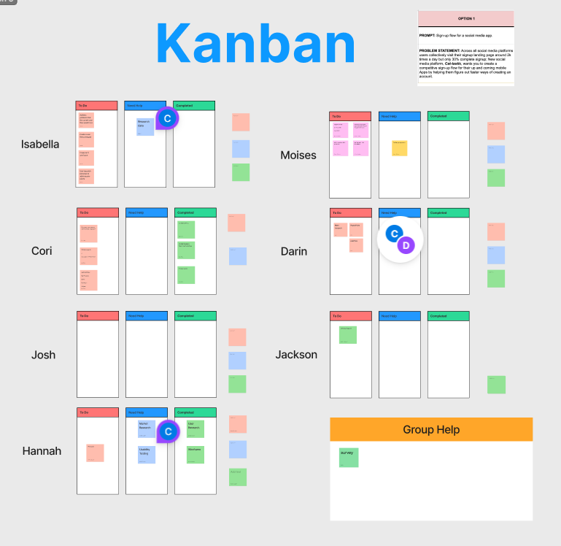

Slide 36
Scope & Constraints
Tell us about the parameters of the work and any special circumstances or limitations that influenced the solution you created.
Working with the overwhelming hatred to biometrics was interesting. It’s such a simple solution and the fear of someone cutting off fingers to break into their device is a real fear.
The simpler you make a design the more opportunities for misinterpretation.
For example, your solution might have been required to have a physical presence in a specific location.
Or, the solution needed to fit into an existing application.

Slide 37
Process
Market Research & Competitive Analysis
User Research & Interviews
Ideation
Prototyping
Affinity & Usability Testing
Iteration
What happened, and why

Slide 38
Market Research & Competitive Analysis
Who else has this problem? - Any social media company NEEDS more signups. So they are all essentially in same boat. Most top tier, like Instagram, have it down to a science, but there is always room for improvement.
What other solutions are out there? - Most have filtered it down to the essentials. Speedy flow with bare minimum required information has been the universal go-to. Introduce security in the mix, this is where apps differ. Verification code is widely used but can cause a huge roadblock. Especially if code can only be sent via cell phone.
Who is using them? - Most top tier; Instagram, Facebook, TikTok.
How are they performing? - The ebb and flow of user wants and needs dictate this field. You can have the greatest sign up page or none at all, but if users don’t like your app, they won’t use it.
What are their flaws? - Where do I start? But to be specific to sign ups, probably bot creations. Not necessarily a flaw but a solution needs to be implemented.
Where are the opportunities for this solution? - This solution is universal and can be implemented on most sign up pages.

Slide 39
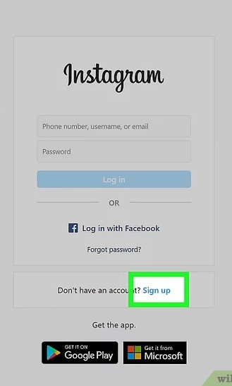
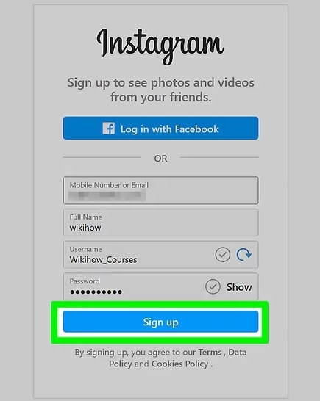
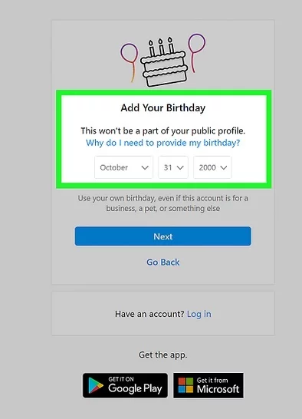
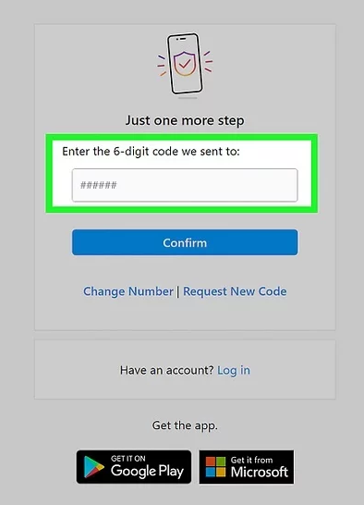
Competitive Analysis - Instagram Sign Up Flow (source wikihow)
Simple and specific. 4 steps, personal account/contact info, birthday (for legal reasons), and verification. All the information you would need up front.
Add photos and screenshots of your research

Slide 40
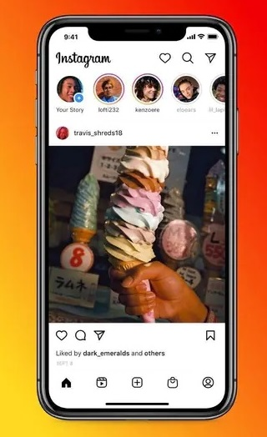
Instagram post to use as reference
Add photos and screenshots of your research

Slide 41
User Research & Interviews
Who did you talk to? - groupmates
Why did you talk to them? - accessable
What did you learn? - Very different and unique perspectives making a solution more difficult. Also a lack of education surrounding the security of storing a biometric.
What sort of frustrations did they have? - Biometrics was a common hatred
What was a highlight or striking quote from the interviews? - The fear of losing an eye or finger if someone wants to break into their phone
What surprised you most? - That biometrics was so hated.

Slide 42
Survey #1 Q & A - Click Me!
Survey #2 Q & A - Click Me!
Add your personas and/or photos and screenshots of your user research

Slide 43
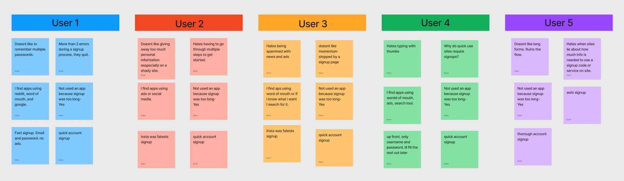
Affinity Mapping
Add your personas and/or photos and screenshots of your user research

Slide 44
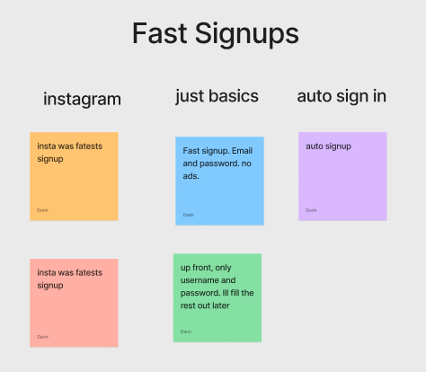
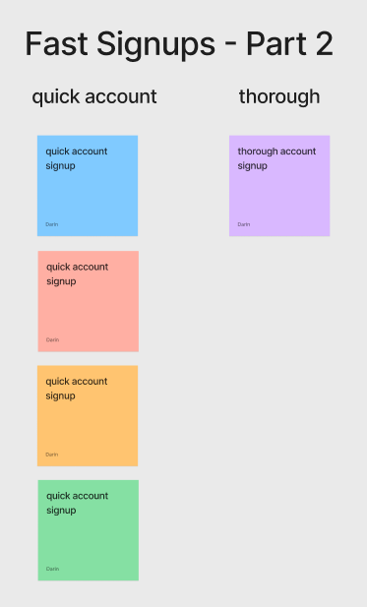
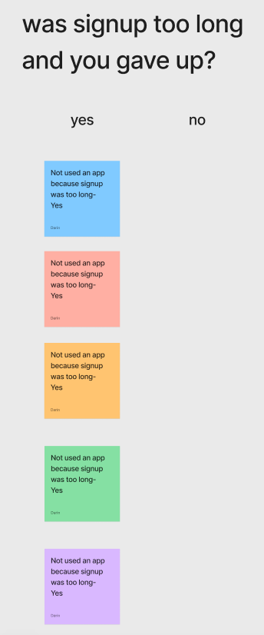
Affinity Mapping
Add your personas and/or photos and screenshots of your user research

Slide 45
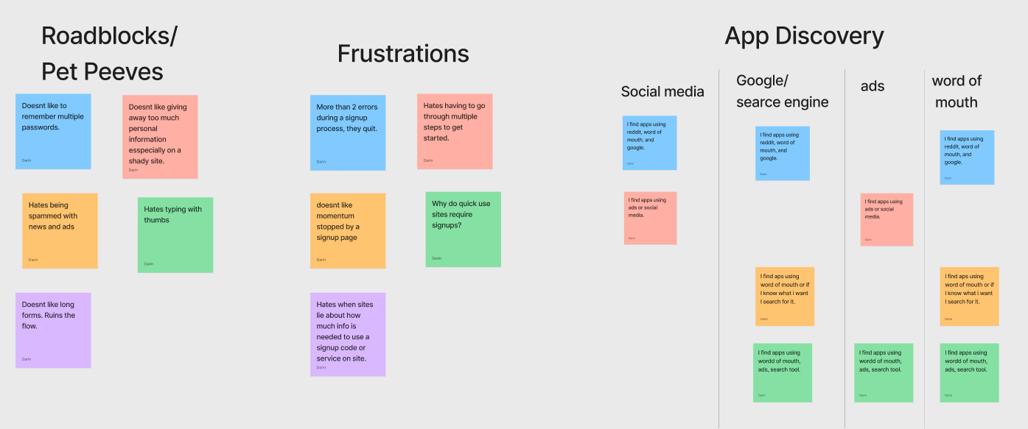
Affinity Mapping
Add your personas and/or photos and screenshots of your user research

Slide 46
Ideation
What process did you follow to generate ideas? - survey, hybrid personas (based on survey users. Not pictured. Used survey users as a type of persona), wireframe, kanban.
How many did you come up with? - Solution? One. Well I had other ideas but they were features to add to magnify this solution but scope was too big to finish on time.
How did you narrow them down? Time constraints.
Which ones did you pick to move forward with? The simple yet effective solution that is universally accepted.
(I may have misunderstood these questions. I’m assuming it’s talking about ideas/solutions)

Slide 47
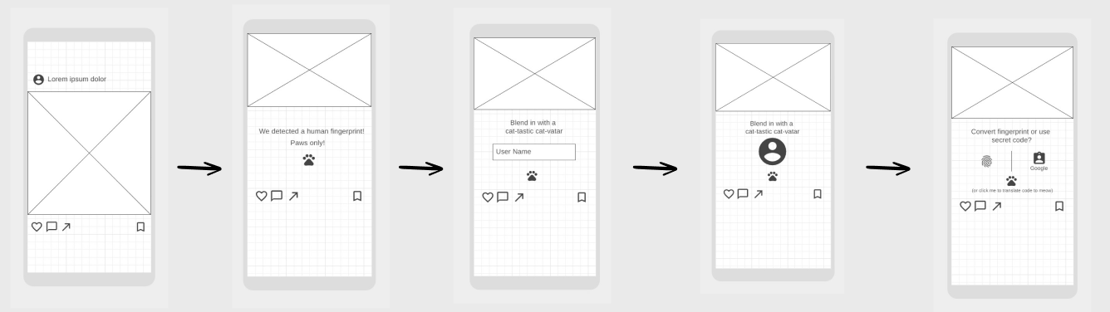
Add photos, screenshots, and mockups of your solution

Slide 48
Prototyping
How did you approach making your prototype? - Since cat-tastic doesn’t exist, I wanted to make the initial landing page recognizable to set a good foundation for the rest of the wireframe to not waste time or confuse the user while presenting something new to them. So I made it look like Instagram
Did you make wireframes or sketches? - Wireframes
What were the requirements for the prototype? - I don’t fully understand this question. I don’t believe there were any requirements. I mean I gave myself some to fit the research. Fun, bite-sized, interactive, speedy.
What challenges did you face while making it? The process includes animations and I lack that skill. Also it's confusing to convey animations in static pictures. The low fidelity version was too vague and confused users. So I had to mix high and low fidelity.

Slide 49
Add photos and screenshots of your prototype

Slide 50
Affinity & Usability Testing
How did testing your prototype go? - not as smoothly as I expected, which is a good thing. I was able to change a few things to make sure the initial idea is relayed properly.
What were the pain points? More negatives than positives. But most negatives were not even about the user flow. The solution was the user flow, which was a success. But realizing how much more work is involved on the mundane was a pain point. Spending time on what should've been evident. But that’s UX and is fun and necessary to learn.
What was successful? The researched portion. Fun, interactive, bite-sized, non-interruptive user flow.
What did you learn? Be specific in the design even though this is a wireframe. Make sure each step is clear and understandable. That people are afraid of biometric and refuse to use it so don’t make it prominent.

Slide 51
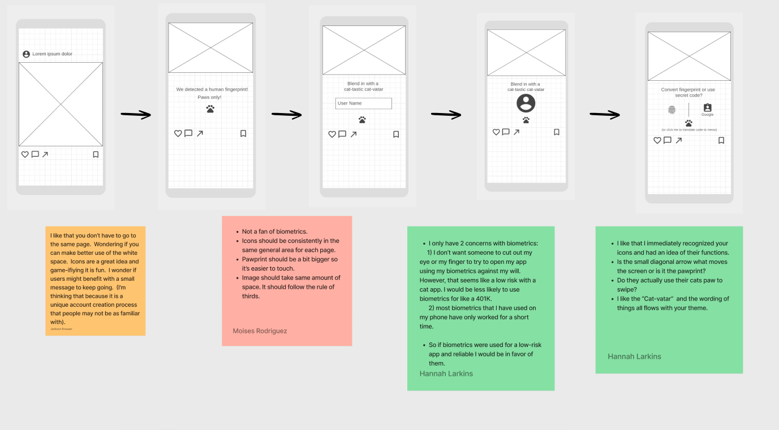
Add photos and screenshots of your affinity or usability testing

Slide 52
Iteration
What did you change? I spent more time making sure the initial design was understandable before I moved on to big changes. For instance I added a picture of a cat to show that it moves off screen instead of being resized. It also connects the user faster to the idea of a cat instagram type app. They are more likely to understand the emotional connection and the wireframe will feel more real helping the feedback be more genuine. Also I added instructions to what is happening during the user flow.
How did you approach making changes? I didn’t want to get off track modifying details if the psychology behind the solution didn’t work. I had to focus on feedback that called out something specific to the signup process and made sure the underlying user flow worked first.
Why did you change those things? - I needed to change some minor details to make sure the next set of feedback was related to the user flow.
What were the results of changing them? The feedback was more focused on the signup process this time and it really helped understand the psyche of if the solution connected with the user.

Slide 53
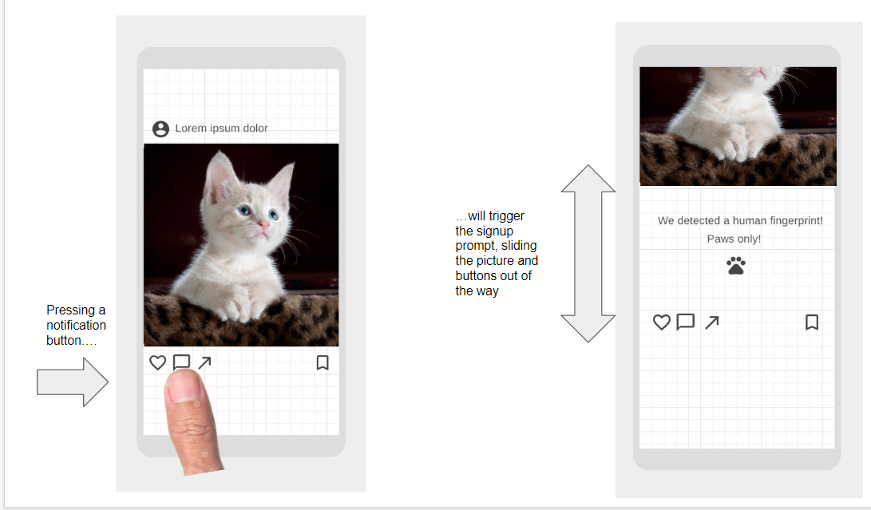
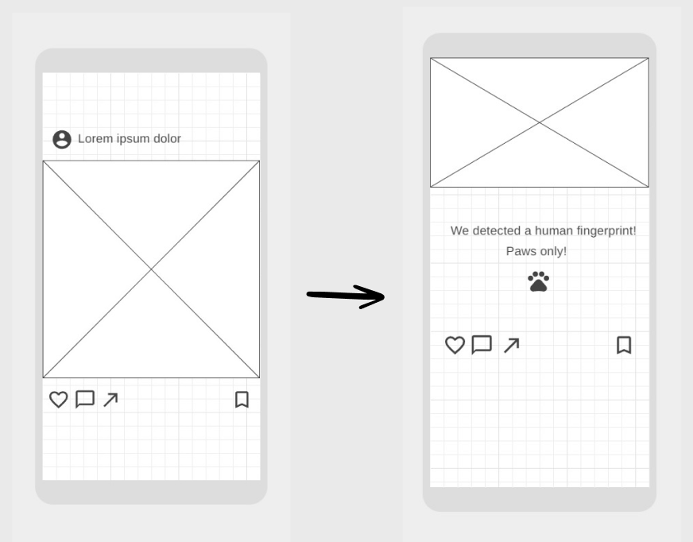
Add photos and screenshots that show how your solution has changed in response to research insights

Slide 54
Conclusion
Results
Challenges
Lessons Learned
Opportunities
Where things ended

Slide 55
Results
What were the ultimate results of your solution? - Overall it connected well with users. I just have to make sure icons and flow are more clear.
Was it successful? Did it fail? - User flow was successful. Finding balance between simple yet intuitive.
Why? - Once it was clarified what was happening, the users were happy with the bite-sized, fun, signup flow.
Remember - it’s okay to create a solution that fails.
What’s important is what you learned.

Slide 56
Challenges
What challenges did you face while creating and testing this solution? - Positive feedback didn’t go much into detail. Negative feedback was were the users explained why.
What part was hardest? Collecting outside data that was specific to this solution. Also the need to cut the scope because of the short amount of time.
How did you overcome it? Focus on user value. Understand any data can be valuable if looked at in a certain perspective.

Slide 57
Lessons Learned
What did you learn? - Focus on foundation. Scope can come later. Educate the public on safe use biometrics.
What takeaways would you share with others? - Focus on foundation. Scope can come later. (I know this is copying but it’s a great takeaway)
What will you apply in the future? - Focusing on foundation. (it really is a good lesson and I need to use it myself)

Slide 58
Opportunities
What opportunities are still left in this solution? - Gamification. Referrals. How to turn turn clicks into dollars. Clarify some of the sign up steps.
What would you do differently, if given the chance? - If I had more time I’d make the scope bigger. I would also do more iteration testing to refine results.
If you were moving forward with another iteration, what direction would you take? - Understand the company value of why more signups are important and add solutions into the process that makes the user value and company value connect.

Slide 59
Q&A

